Slide 1
Mule ESB:
Making integration easy
Serhiy Yakovyn

Slide 2
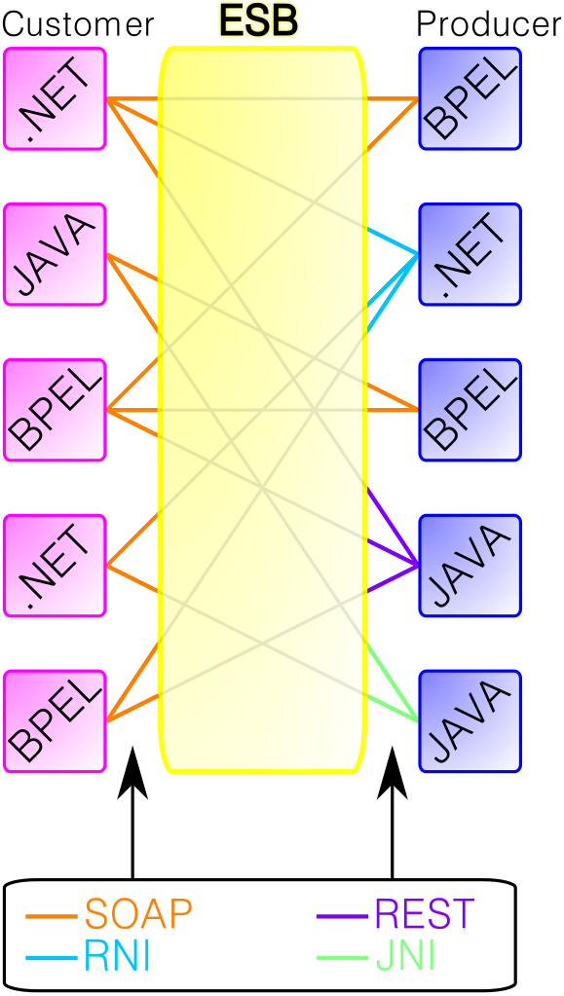
Why ESB?

Slide 3
Why Mule ESB?
Java ESBs: http://java-source.net/open-source/enterprise-service-bus
The answer came from a client: Mule (3.0) is the best (2010-2011 years)
Evaluated: JBoss ESB, Spring Integration and others

Slide 4
Simple?
Eclipse based IDE, available as plugin too (3.8.x only)
Easy to graphical designer
Definitely simple to use

Slide 5
Always that simple?
Sometimes documentation is not good
Making CXF client to work was a difficult experience
Use Client-side Proxying when needed
Use Java/Groovy component when in lockup

Slide 6
Pitfalls
Be careful with CXF components
Use files and queues
CE vs EE editions

Slide 7
Working examples
Hello world
SOAP web service security
REST API with API Kit

Slide 8

Questions

Slide 9
Useful links
http://www.mulesoft.org/documentation/display/current/Home
http://java-source.net/open-source/enterprise-service-bus

